Slide 1
MATH221
Mathematics for Computer Science
Unit 6
Number Systems

Slide 2
OBJECTIVES
Know what is the natural numbers and integers.
Understand what is binary operation and closed binary operation.
Understand the algebraic terminologies, identity, inverse, commutative, associative and distributive.
Know what is the well-ordered property.
Understand the application of the definition of odd and even integers.
Know what are prime and composite numbers.

Slide 3
The Natural Numbers
The Natural Numbers, denoted by ℕ, consist of all positive “whole” numbers.
ℕ = {1, 2, 3, 4, …}
Is 0 an element of ℕ (notation 0 ∈ ℕ)?
No.

Slide 4
Binary Operations
An operation on a set S is a rule for combining one or more elements of S.
A binary operation on S is a rule for combining pairs of elements of S to produce another element.
We denote a general operation by ∗. A binary operation ∗ on S is closed on S if
  x, y ∈ S ⇒ x∗y ∈ S.

Slide 5
Binary Operations
On numbers we have four main binary operations: addition, subtraction, multiplication and division.
But on which number systems are these binary operations closed?

Slide 6
Binary Operation
We can picture such an operation as a “black box” that takes two inputs from the set and produces one output in the set:
Input 1
Output
Input 2
6

Slide 7
Binary Operation: Example
If the set is ℕ and the operation is +, then the inputs 1 and 2 would result in the output 3.
1
+
3
2
7

Slide 8
Exercise:
Among addition, subtraction, multiplication and division are all binary operations on ℝ , which of them are closed on ℕ?
Why or why not?
Addition [4 + 2 = 6]
Yes
Subtraction [4 – 2 = 2]
No. 2 - 4 = -2
Multiplication [4 × 2 = 8]
Yes
Division [4 ÷ 2 = 2]
No. 2 ÷ 4 = 1/2

Slide 9
Identity
Suppose ∗ is a binary operation on a set S. An element e of S is called an identity if for all x ∈ S we have
e ∗ x = x and x ∗ e = x
Does ℕ have an identity under the addition and multiplication operations?
  Addition: no
  Multiplication: yes, it is 1 as 1×n = n and n×1 =n.

Slide 10
Inverse
Suppose ∗ is a binary operation on a set S , and e ∈ S is an identity. An element x ∈ S is called invertible if there exists an element y ∈ S such that
  x ∗ y = e and y ∗ x = e .
In this case y is called the inverse of x .
What are the invertible elements of ℕ under the addition and multiplication operations?
Addition: not applicable
Multiplication: 1 only

Slide 11
Commutativity and Associativity
A binary operation ∗ on a set S is commutative if
  x ∗ y = y ∗ x for all x , y ∈ S .
A binary operation ∗ on a set S is associative if
(x ∗ y ) ∗ z = x ∗ (y ∗ z ) for all x , y , z ∈ S .
Are addition and multiplication on ℕ commutative and associative operations? Yes

Slide 12
Example: Paper-Scissors-Rock
Let M := {p, s , r } and consider the paper-scissors-rock-inspired binary operation ∗ on M given by
  p ∗ r = r ∗ p = p (paper beats rock)
  p ∗ s = s ∗ p = s (scissors beats paper)
  s ∗ r = r ∗ s = r (rock beats scissors)
  p ∗ p = p (paper ties with paper)
  s ∗ s = s (scissors ties with scissors)
  r ∗ r = r (rock ties with rock).
Note that * is closed on M.

Slide 13
Example: Paper-Scissors-Rock (cont’d)
This binary operation is by definition commutative. But it is not associative:
  (r ∗ p) ∗ s = p ∗ s = s
  r ∗ (p ∗ s ) = r ∗ s = r

Slide 14
Distributivity
For each a, b, c ∈ ℕ we have,
  a × (b + c ) = (a × b) + (a × c )
  (a + b) × c = (a × c ) + (b × c )
We say multiplication distributes over addition in ℕ.
Note that addition does not distribute over multiplication. For instance?
2 + (3 × 1) ≠ (2 + 3) × (2 + 1)

Slide 15
Exercise:
Carefully write down every small step you take when simplifying the following expressions without the aid of a calculator. Can you give reasons for each step?
3x + 4y + 2x + y
= 3x + (4y + 2x) + y Associative law
= 3x + (2x + 4y) + y Commutative law
= (3x + 2x) + 4y + y Associative law
= (3 + 2)x + 4y + y Distributive law
= 5x + 4y + y Arithmetic
= 5x + (4y + y) Associative law
= 5x + (4 + 1)y Distributive law
= 5x + 5y Arithmetic

Slide 16
Well-ordering property
A set S together with an order ≤ is called well-ordered if every nonempty subset of S has a least element. That is, if A is a nonempty subset of S , then there is an s₀ ∈ A such that s₀ ≤ s for all s ∈ A.
Axiom:
The natural numbers ℕ with the usual order ≤ is well-ordered.

Slide 17
The integers Z
The integers Z is the collection of all the “whole” positive and negative numbers, and 0. So
  Z = {. . . , −3, −2, −1, 0, 1, 2, 3, . . . }.
The order ≤ on N extends to the natural order ≤ on Z.
Axiom:
Any nonempty subset of integers that are greater than a fixed integer with the usual order ≤ is well-ordered.

Slide 18
Operations, identities and inverses on Z
We have the usual binary operations +, −, × and ÷ on Z. But only the operations +, − and × are closed on Z.
Does Z have an identity under the + and × operations?
What are the invertible elements in Z under the + and × operations?

Slide 19
Commutativity and associativity
Addition and multiplication are commutative operations on Z. But subtraction is not:
  10 – 5 ≠ 5 -10
Addition and multiplication are associative operations on Z. But subtraction is not:
(10 – 2) - 3 ≠ 10 – (2 - 3)

Slide 20
Distributivity
For each a, b, c ∈ Z we have
  a × (b ± c ) = (a × b) ± (a × c )
  (a ± b) × c = (a × c ) ± (b × c )
We say multiplication distributes over addition and subtraction in Z.

Slide 21
Well-ordering property
Recall that a set S together with an order ≤ is called well-ordered if every nonempty subset of S has a least element, that is, if A is a nonempty subset of S , then there is a s₀ ∈ A such that s₀ ≤ s for all s ∈ A.
We have seen that the natural numbers N with the usual order ≤ is well-ordered.
Fact: The integers Z are not well-ordered with ≤.

Slide 22
Evens, odds, primes and composites
An integer m ∈ Z is even if m = 2j for some j ∈ Z.
An integer n is odd if n = 2k + 1 for some k ∈ Z.
An integer n > 1 is prime if whenever n = r × s for positive integers r and s , we have r = 1 or s = 1. An integer n > 1 is composite if it is not prime.
Example: -2 is an even integer, 5 and -3 are odd integers, 5 is a prime integer and 4 is a composite integer.

Slide 23

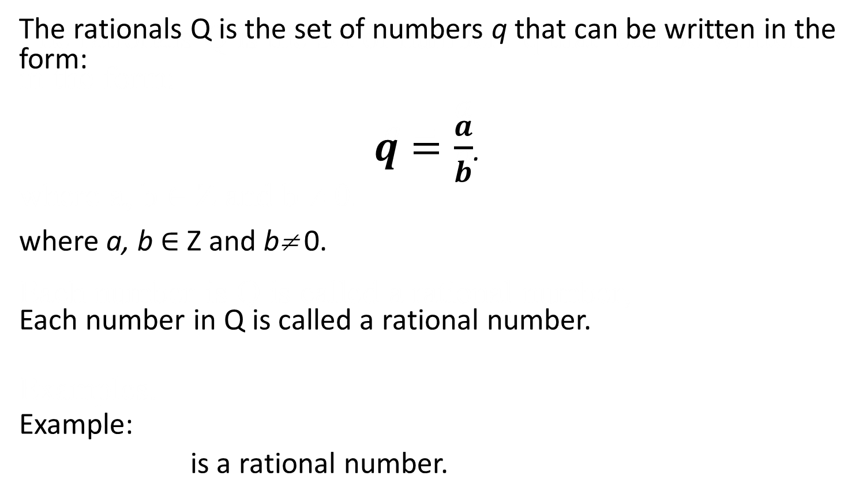

The rationals Q
A number is irrational if it is not rational; that is, if it can not be written
The rationals Q is the set of numbers q that can be written in the form:
$q=\frac{a}{b}$.
where a, b ∈ Z and b≠ 0.
Each number in Q is called a rational number.
Example:
is a rational number.
$$0.4= 2/5$$

Slide 24
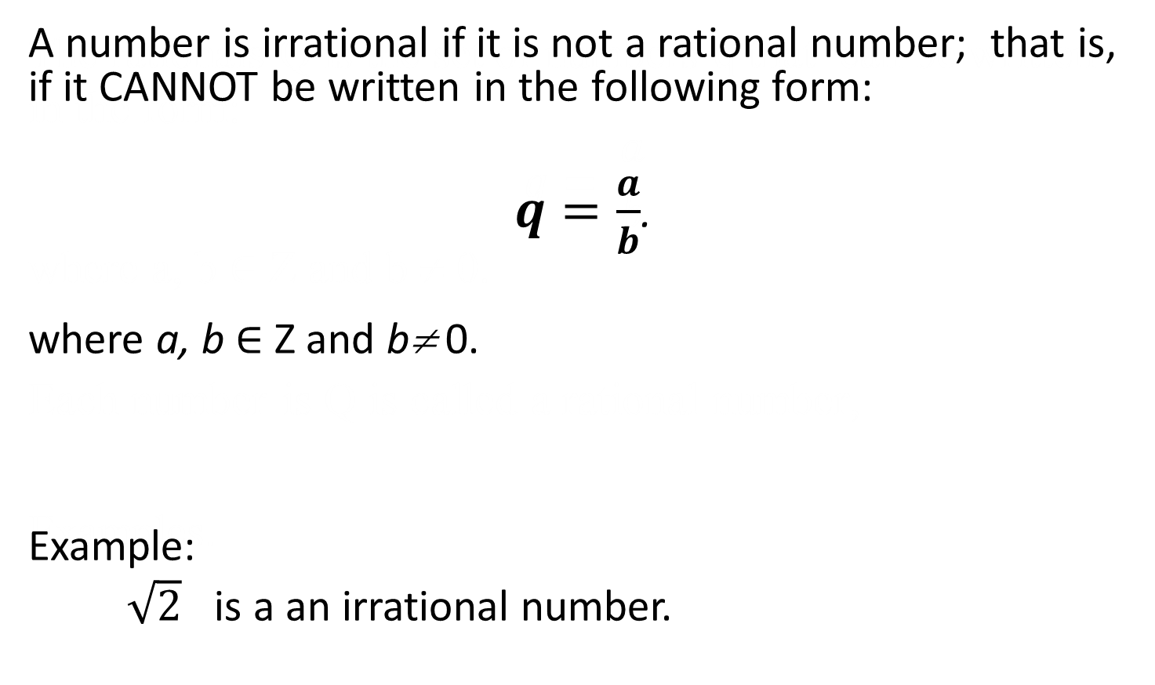
Irrational
A number is irrational if it is not rational; that is, if it can not be written
A number is irrational if it is not a rational number; that is, if it CANNOT be written in the following form:
$q=\frac{a}{b}$.
where a, b ∈ Z and b≠ 0.
Example:
$\sqrt{2}$ is a an irrational number.

Slide 25
End of Unit 6

